Slide 1
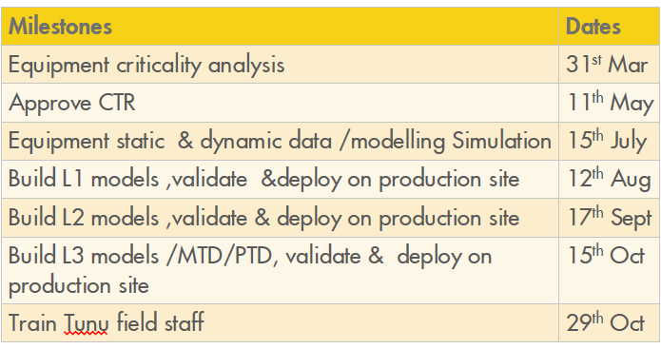
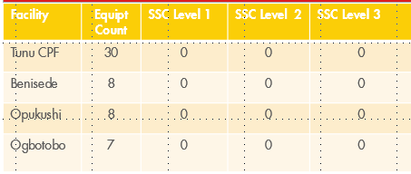

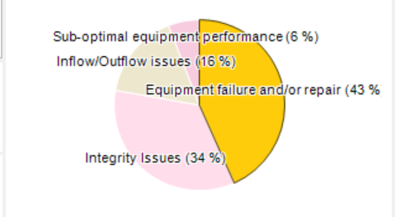
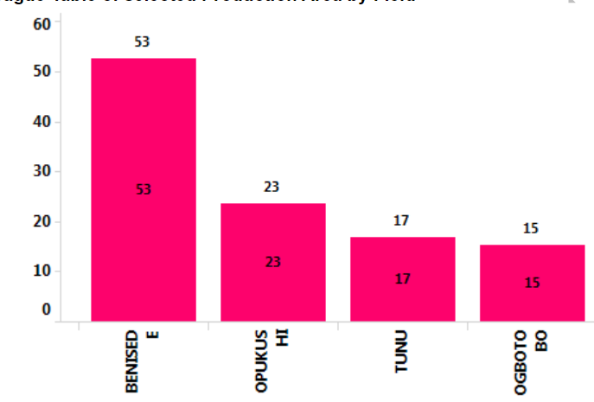
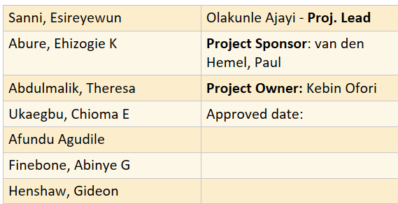
Implement SMART CONNECT on Critical Rotating Equipment @ tunu Node by Oct 2020
Implement SMARTCONNECT on Critical Rotating Equipment @ Tunu Node by Oct 2020
UPDATED: 7/07/2020
NEXT REVIEW: TBA
LoB
Project Title
Date Updated/
Next Review Due
Reliability Engineering
Desired Benefits
Achieve 20% (22.46boe) reduction in Total Hydrocarbon Production loss by Oct 2021.
Desired Benefits
How to FIX IT ?
Build Machines Train ( L1-run status , L2-performance & L3- Health monitoring) Models
Validate models
Deploy Machine Model to Shell Smart Connect web domain
Train Site team
PLAN (IMPLEMENTATION)
What is the PROBLEM?
All production critical rotating equipt at Tunu node are not hooked up to Shell Smart Connect. Hence,Important machine information are not displayed on the web for machine performance and health monitoring. Lack of remote access to the rotating equipment by specialised staff, for incipient failure condition detection and swift intervention, could result in catastrophic failure and high maintenance cost incurred. According to the GPD report, from January to July 2020 , the deferment figure across tunu node is 117KBOE. 50% of the deferment rate is attributed to failure / sub optimal performance of equipment. These equipment include 3 gas turbine generator, 8 gas turbine driven compressor train,10 booster compressors,2 screw compressors,7 air coolers,11 gas engine generators and 26 electric motors.
CURRENT CONDITIONS: Level of Smartness of Critical Equipment
GOALS (SMART)
Reduce Unscheduled production deferment due to equipment failure by 20% from Jan 2021
Reduce equipment breakdown maintenance cost by 20% annually.from Jan 2021
Business Outcome/Follow up Measure.
ANALYSIS
Tunu node deferment cause analysis -2020 YTD
Team
Notes:
15 Mins

